Slide 1
Impact of Pandemic on Real Estate and Economic Outlook
Lawrence Yun
Chief Economist and Senior Vice President
National Association of Realtors®

Slide 2
Jobs Recovery need another 9.8 million to get us to prior peak
TITLE
SUBTITLE

Slide 3
Monthly Job Additions Fizzling Out?
TITLE
SUBTITLE

Slide 4
Jobs in Charlottesville
TITLE
SUBTITLE

Slide 5
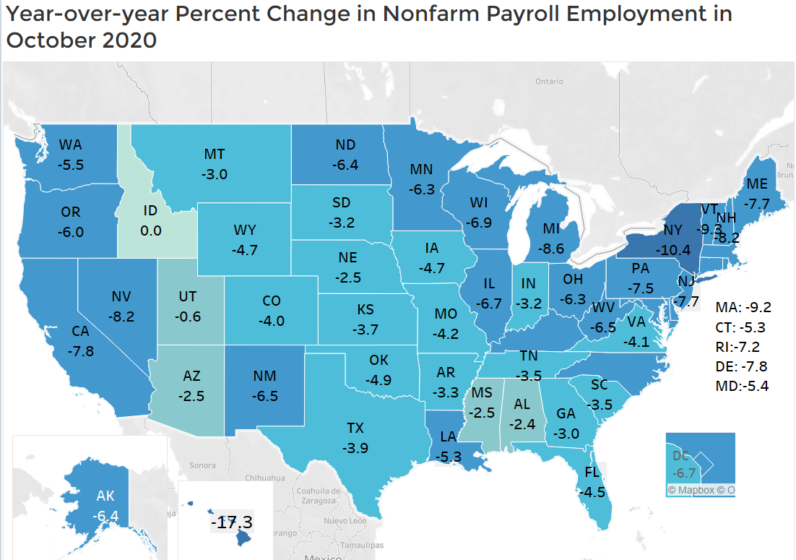
All States with Fewer Jobs … U.S. average decline of 6.1%
TITLE
SUBTITLE

Slide 6
Income boosted from stimulus checks
($ billion)
TITLE
SUBTITLE

Slide 7
Savings Rate still elevated … ready to pump up the economy after vaccine
TITLE
SUBTITLE

Slide 8
Remarkable Housing Market

Slide 9
Existing Home Sales
TITLE
SUBTITLE

Slide 10
New Home Sales
TITLE
SUBTITLE

Slide 11
Pending Contract … Breaking Out Higher
TITLE
SUBTITLE

Slide 12
Mortgage Application to Buy a Home
TITLE
SUBTITLE

Slide 13
30-Year Mortgage Rates
TITLE
SUBTITLE

Slide 14
Housing Asset Valuation minus Mortgage Outstanding = $20.2 trillion

Slide 15
Months Supply of Existing Home Inventory
TITLE
SUBTITLE

Slide 16
Housing Starts … Need a Huge Ramp Up
TITLE
SUBTITLE

Slide 17
Price of Softwood Lumber
TITLE
SUBTITLE

Slide 18
Work-From-Home and
Change in Location Preference?

Slide 19
Office Occupancy Falls (-74 million square feet in Q2 and Q3)
TITLE
SUBTITLE

Slide 20
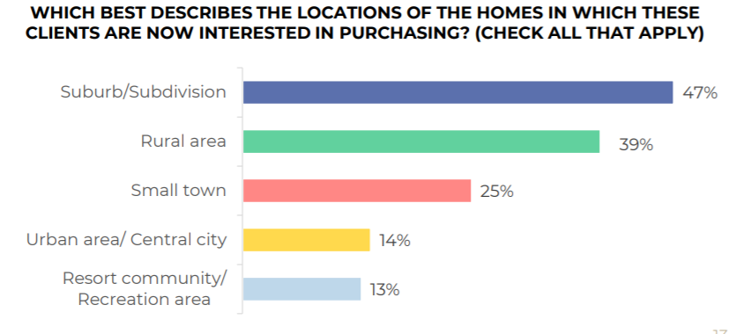
REALTOR® Survey about their Clients Residential Choice
TITLE
SUBTITLE

Slide 21
Home Sales in Vacation Counties much Stronger
TITLE
SUBTITLE

Slide 22
Economic Forecast
 | 2019 | 2020 Forecast | 2021 Forecast
GDP Growth | 2.3% | -5% | +4%
Job Gains | +2.2 million | - 7 million | + 3 million
10-Year Treasury | 2.1% | 0.9% | 1.0%
Consumer Price Inflation | 1.8% | 1.0% | 1.6%
TITLE
SUBTITLE

Slide 23
Housing Market Forecast
 | 2019 | 2020 Forecast | 2021 Forecast
Mortgage Rates | 3.9% | 3.0% | 3.1%
New Home Sales | +11% | +20% | +23%
Existing Home Sales | 0% | 3% | 9%
Home Price | 4.9% | 6% | 3%
TITLE
SUBTITLE

Slide 24
Biden Presidency
Homebuyer tax credit … $15,000 at closing
1031 exchange vulnerable … land sales to developable lots
Looser Monetary Policy
Bigger Fiscal Policy … extend mortgage forbearance?
Temporary Lockdown to contain virus?

Slide 25
TITLE
Thank You
SUBTITLE

